Slide 1

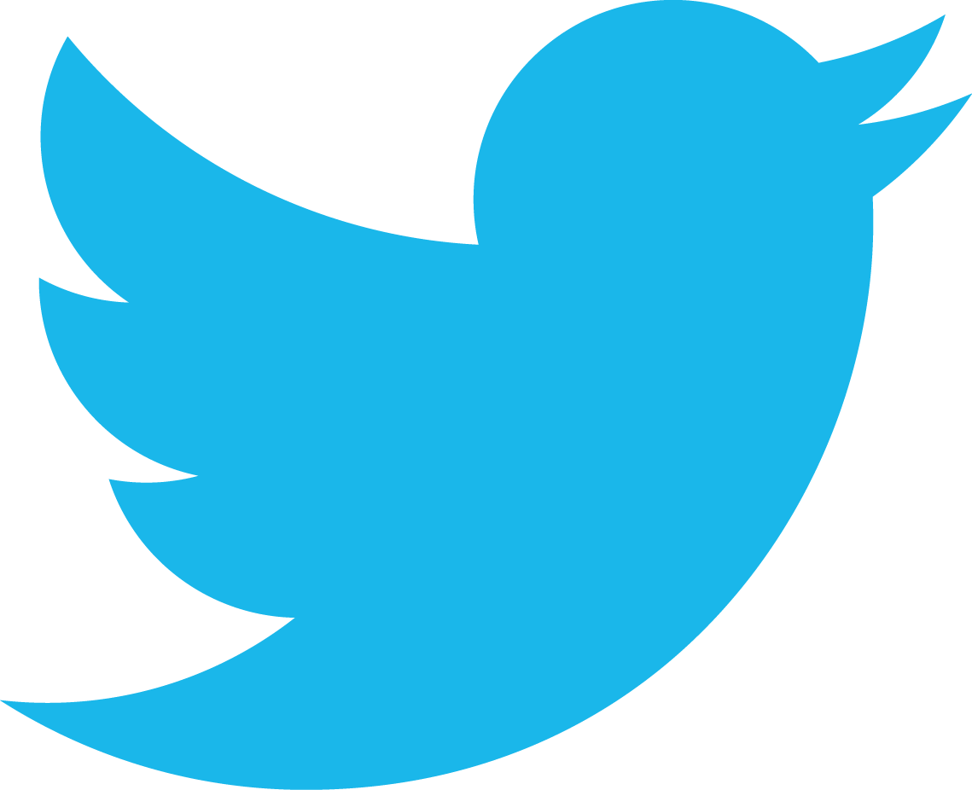
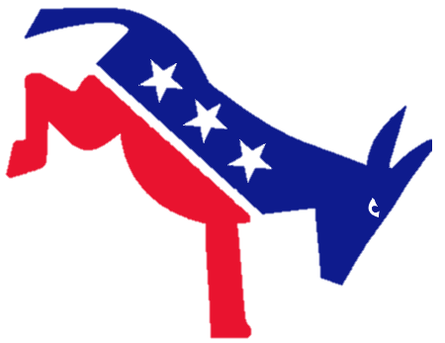
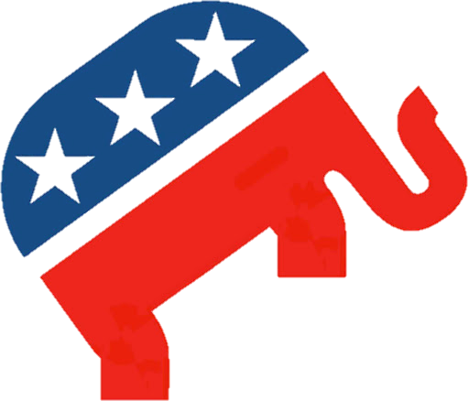
vs
TWEET
DIFFERENCES

Slide 2
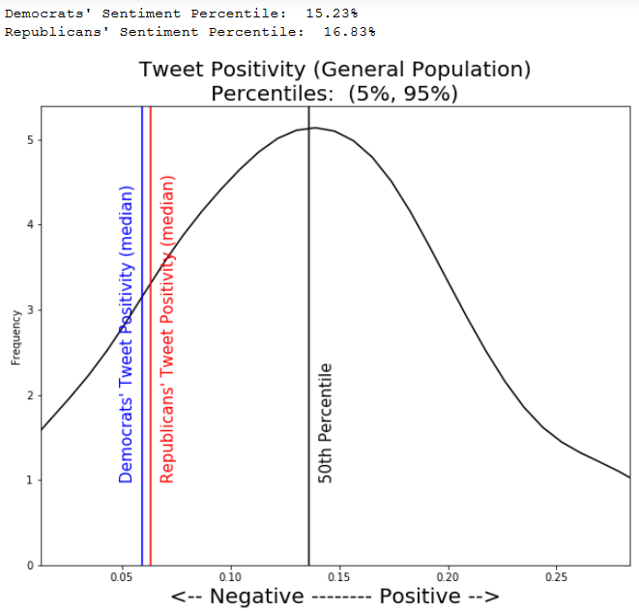
TWEET POSITIVTY Compared to General Population

Slide 3
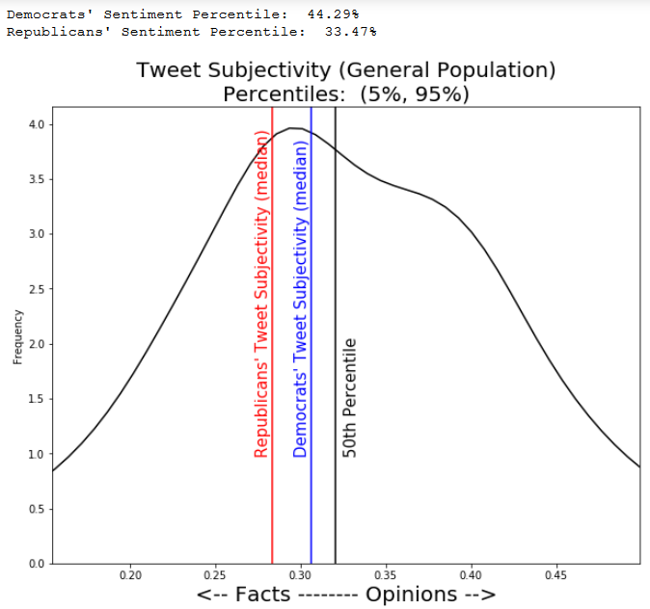
TWEET SUBJECTIVITY Compared to General Population

Slide 4
Popular Words Democrats
Tump
golfs
golfing
bleach
ignored warnings
Trump’s
presidency
threatened
resign
Dislikes:

Slide 5
Popular Words Democrats
Mitch McConnel
Lindsey Graham
Dominic Cummings
cult
GOP
Dislikes:

Slide 6
Popular Words Democrats
violated
devastating
selfish
Putin
terrorism
struggling
bots
viruses
Concerns:

Slide 7
Popular Words Democrats
equality
safer
universal
eligible
Values:

Slide 8
Popular Words Democrats
writing
inspiration
lessons
strategy
Elizabeth Warren
Tara Reid
artist
zoom
Interests:

Slide 9
Popular Words Republicans
Ilhan Omar
sleepy
youaintblack
Gretchen Whitmer
prosecuted
Joe Biden
obamagate
dems
liberals
Adam Schiff
James Comey
Dislikes:

Slide 10
Popular Words Republicans
CCP
fakenews
MSM
coup
communist
mainstream
terrorists
Wuhan
planned parenthood
funded
Dislikes:

Slide 11
Popular Words Republicans
Values:
patriots
earned
amen
greatness

Slide 12
Popular Words Republicans
Interests:
Heisman

